Slide 1

PROJECT: Stopwatch And Countdown
SUB: Advance Web Programming
NAME: PRAPHOOL KUMAR
REGDNO.:190301120085
BRANCH:CSE,4TH SEM, BBSR
NAME: BIKASH BARIK
REGDNO.:190301120075
BRANCH:CSE,4TH SEM, BBSR

Slide 2

Introduction
The digital stopwatch we designed is a time-keeping device that is meant to measure the time elapsed from the start to end of any event. The stopwatch has several different functions including pause (which represents both start and stop), reset.
A stopwatch is a handheld timepiece designed to measure the amount of time that elapses between its activation and deactivation. A large digital version of a stopwatch designed for viewing at a distance, as in a sports stadium, is called a stop clock.
We used the here CSS,Javascript and HTML to make this application. The website was used to implement our digital stopwatch, and LCD screen was used to display the counter time and the elapsed time.

Slide 3
Objectives
The objectives of this project: Build a fully functional stopwatch websiteb using HTML,CSS and Javascript. The timer is really just a count down counter (i.e. it counts down to 0). When Reset is a “1” or if the counter value reaches 0, the counter gets reloaded with the preload value (supplied on the load number input port) and then begins counting back down to 0.
Provide a useful timer. For races, velocity measurements, etc.
Be accessible to innumerate users. Help develop numeracy.

Slide 4
Web Development Language Used
HTML(Hypertext Markup Language)
CSS(Cascading style sheet
Javascript

Slide 5
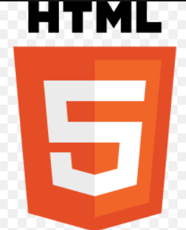
HTML
HTML is an acronym which stands for Hyper Text Markup Language which is used for creating web pages and web applications. Let's see what is meant by Hypertext Markup Language, and Web page.
Hyper Text: HyperText simply means "Text within Text." A text has a link within it, is a hypertext. Whenever you click on a link which brings you to a new webpage, you have clicked on a hypertext. HyperText is a way to link two or more web pages (HTML documents) with each other.
Markup language: A markup language is a computer language that is used to apply layout and formatting conventions to a text document. Markup language makes text more interactive and dynamic. It can turn text into images, tables, links, etc.

Slide 6
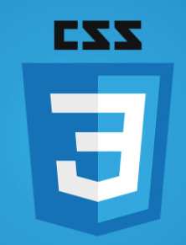
CSS
CSS stands for Cascading Style Sheets. It is a style sheet language which is used to describe the look and formatting of a document written in markup language. It provides an additional feature to HTML. It is generally used with HTML to change the style of web pages and user interfaces. It can also be used with any kind of XML documents including plain XML, SVG and XUL.
CSS is used along with HTML and JavaScript in most websites to create user interfaces for web applications and user interfaces for many mobile applications.

Slide 7
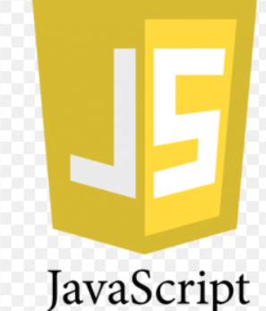
Javascript
JavaScript (js) is a light-weight object-oriented programming language which is used by several websites for scripting the webpages.
It is an interpreted, full-fledged programming language that enables dynamic interactivity on websites when applied to an HTML document.
JavaScript follows the syntax and structure of the C programming language. Thus, it is a structured programming language.
JavaScript is a weakly typed language, where certain types are implicitly cast (depending on the operation).

Slide 8
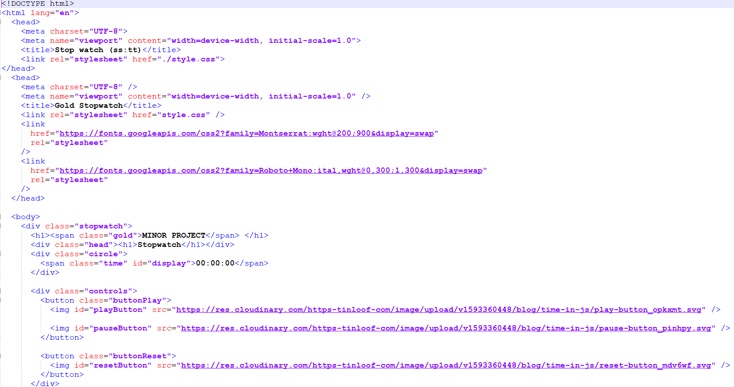
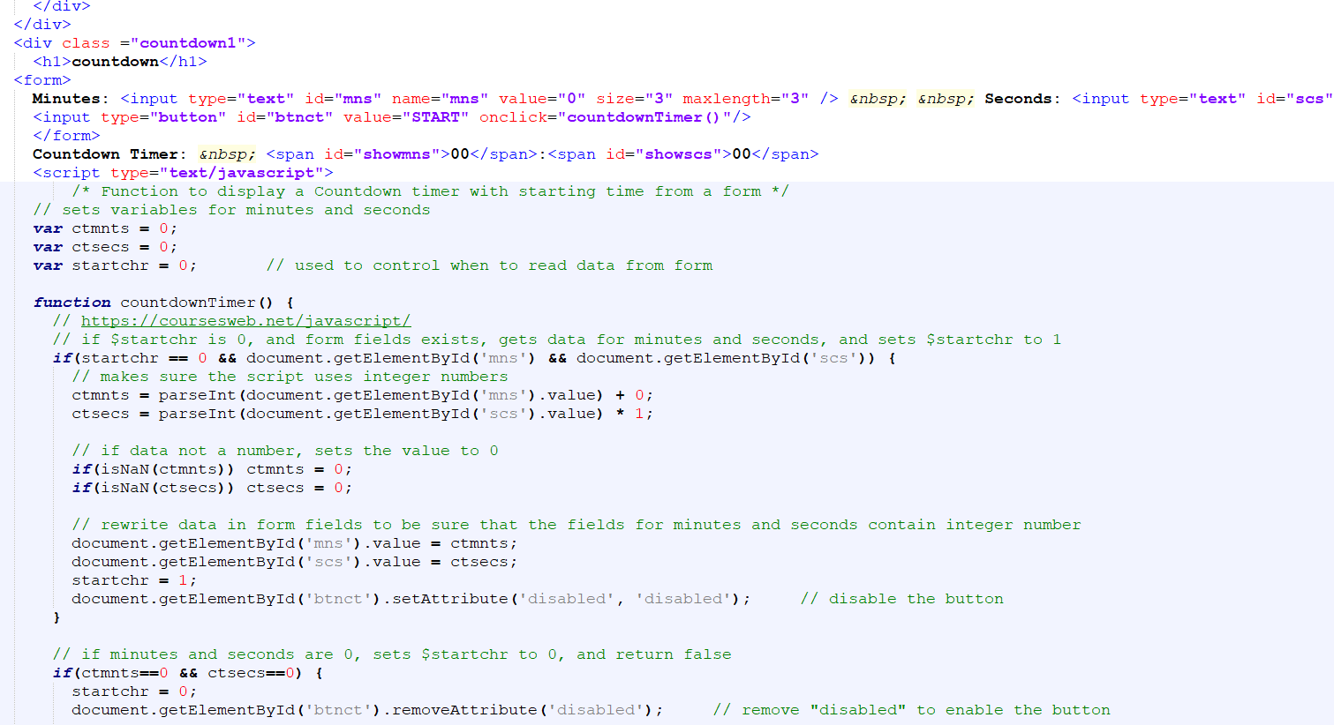
Coding

Slide 9
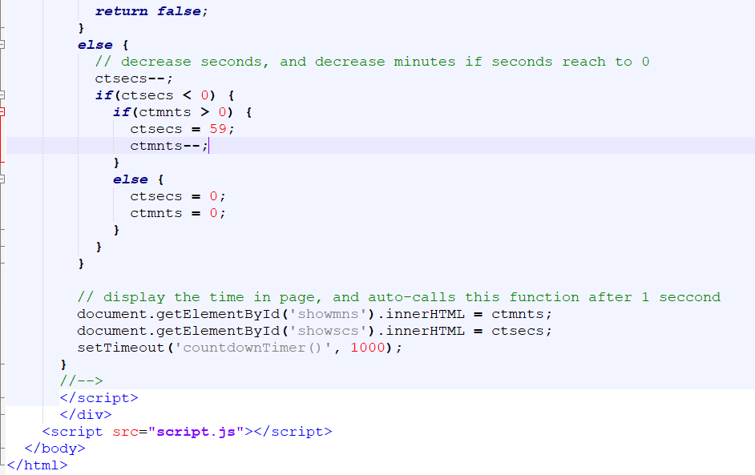

Slide 10
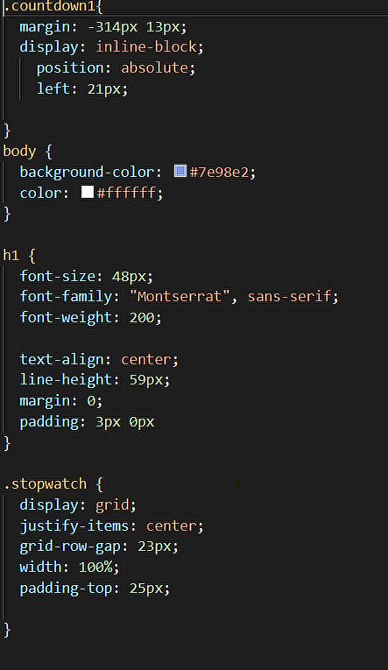
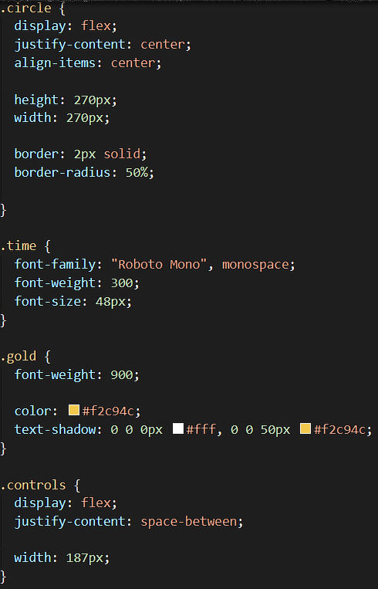
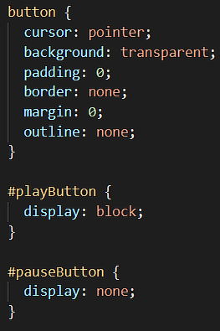
Style.css

Slide 11
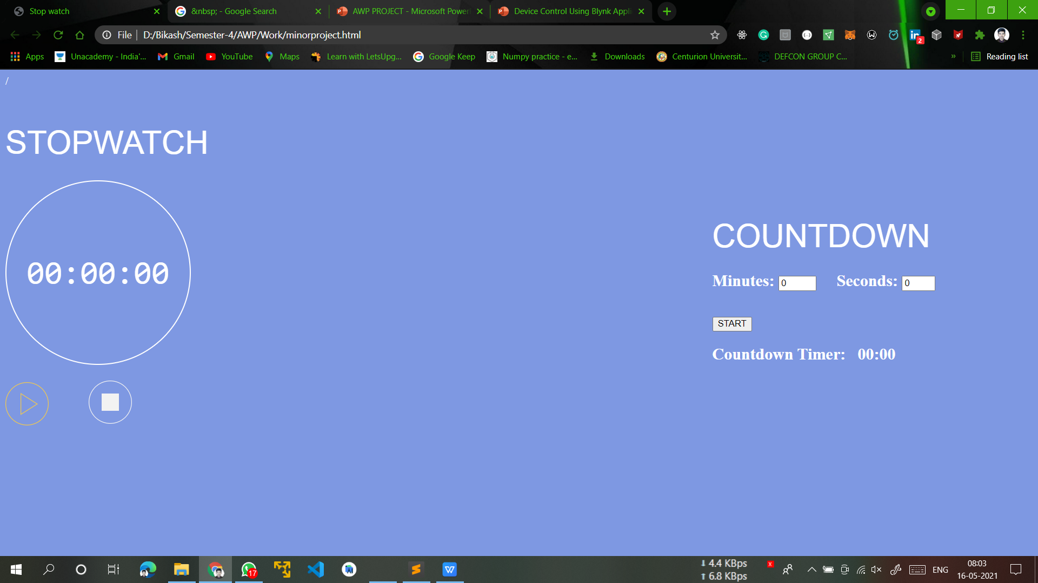
Results

Slide 12
Conclusion
After we done our project Stopwatch and Countdown, we are able to learn and developed knowledge in designing by used JavaScript , HTML,CSS. we also learn to developed skills and knowledge in systematic design approach. According to our project we are able to use the different language like CSS, JavaScript and can compare the best method can be used to write the program.

Slide 13


